Slide 1
Algorithm Analysis and Data Structures
Exercises
Pramote Kuacharoen

Slide 2
Class Shape
Initializes color
Method get_color
Method set_color
Method get_area returns 0
Method get_circumference return 0
Method __str__ returns a string representing the shape

Slide 3
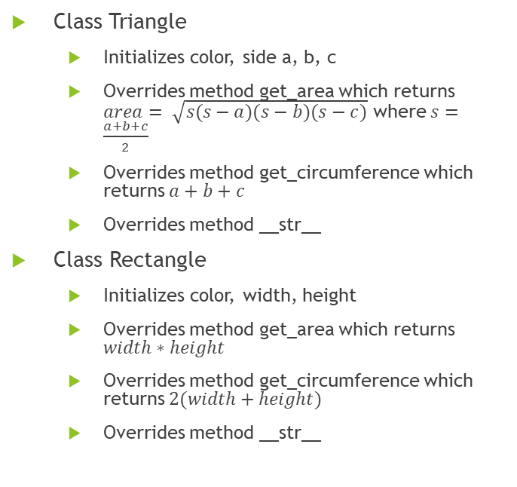
Subclasses of Shape
Class Circle
Initializes color and radius
Overrides method get_area which returns $A=πr^{2}$
Overrides method get_circumference which returns $C=2πr$
Overrides method __str__
Class Square
Initializes color and width
Overrides method get_area which returns $width∗width$
Overrides method get_circumference which returns $4width$
Overrides method __str__
Class Triangle
Initializes color, side a, b, c
Overrides method get_area which returns $area= \sqrt{s(s−a)(s−b)(s−c)}$ where $s=\frac{a+b+c}{2}$
Overrides method get_circumference which returns $a+b+c$
Overrides method __str__
Class Rectangle
Initializes color, width, height
Overrides method get_area which returns $width∗height$
Overrides method get_circumference which returns $2(width+height)$
Overrides method __str__

Slide 4
Class Student
name, midterm, final
Initializes with default parameters: name=‘’, midterm=0, final=0
Method get_name
Methods set_name, set_midterm, set_final
Method __str__ returns name and semester grade

Slide 5
Class LGStudent
Method calc_semester_grade
Average : [90-100]: A
[80-90) : B
[70-80) : C
[60-70) : D
[0-69) : F
Overrides method __str__ to display name, grade, and full-time

Slide 6
Class PFStudent
__init__ accepts name=‘’, midterm=0, final=0,full_time=True
Method set_full_time, get_full_time
Method calc_semester_grade average>=60 return ‘Pass’ otherwise ‘Fail’
Method __str__ returns a string representing of object

Slide 7
Class Course
Stores course_name and students
__init__ accepts course_name and initializes students to an empty list
Method add_student adds a new student to the course
Method get_students returns the students in the course
Method get_number_of_students returns the number of students in the course
Method get_course_name return the course name
Method drop_student drops a student from the course. The method accepts the string name of the student.

Slide 8
Field of Study
Read Degrees.dat
Format
Field
# degrees conferred in 1981
# degrees conferred in 2010

